Slide 3
Agenda
Introduction to P5
FutureNow FNIP Product Line
FutureNow FNBUS Product Line briefly
Discussion

Slide 4
The History
of P5
1996 P5 founded
1997 P5 steers towards Home Automation. Import of American systems
1999 Installation of first large – scale systems
2000 Development of FutureNow products begins
2002 First FutureNow Bus based products released
2002 – 2009 FutureNow units sold in Europe in quantity
2009 Drivers made for third party control systems
Notes:
4

Slide 5
The History
of P5
2010 Export of FUTUREnow to European countries growing
2011 FNIP product line developments started
2012 FutureNow products are successfully sold all over the world
2012 FNIP Relay and Blind Controller modules launched
2013 FNIP State of the Art Dimmer launched
2014 FNIP LED dimmer launched
2016 FNIP Thermostat launched
Notes:
5

Slide 6
Advantages
Of FutureNow
Simple and Robust Design
Based on many years of integration/installation experience
Meets European Requirements and Standards
Open System with communication protocol available
Easy to Integrate with 3rd party controllers - drivers available
Standalone operation via local inputs, web site and mobile apps
Easy to install – integration can be done in stages
Notes:
6

Slide 7
Advantages
Of FutureNow
Scalability
Quality - Development and Manufacturing in Europe
Affordable Price Point
Support, Support and Support
Notes:
7

Slide 8
Agenda
Introduction to P5
FutureNow FNIP Product Line
FutureNow FNBUS Product Line briefly
Discussion

Slide 9
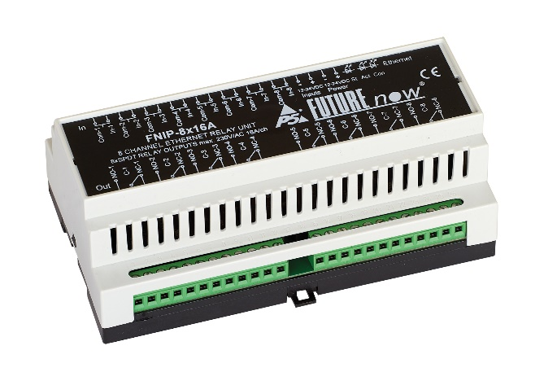
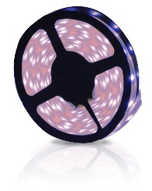
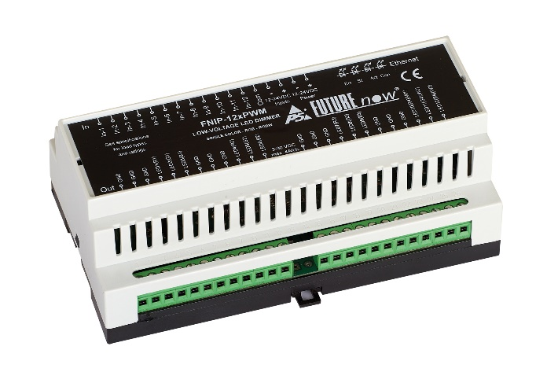
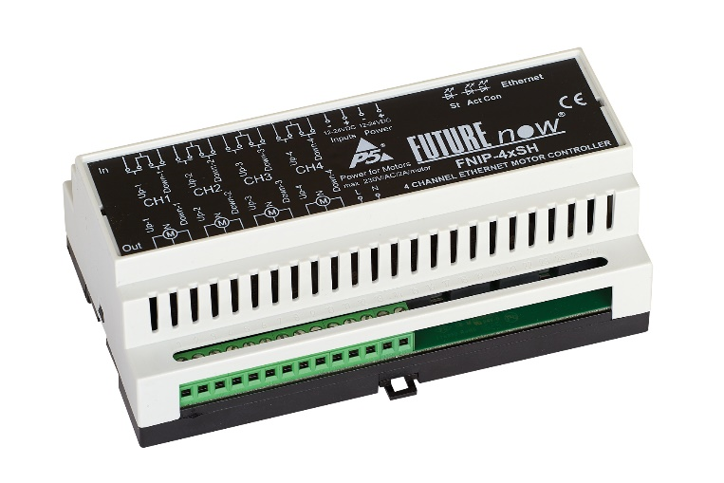
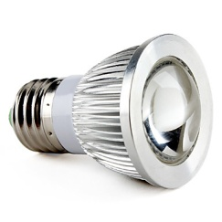
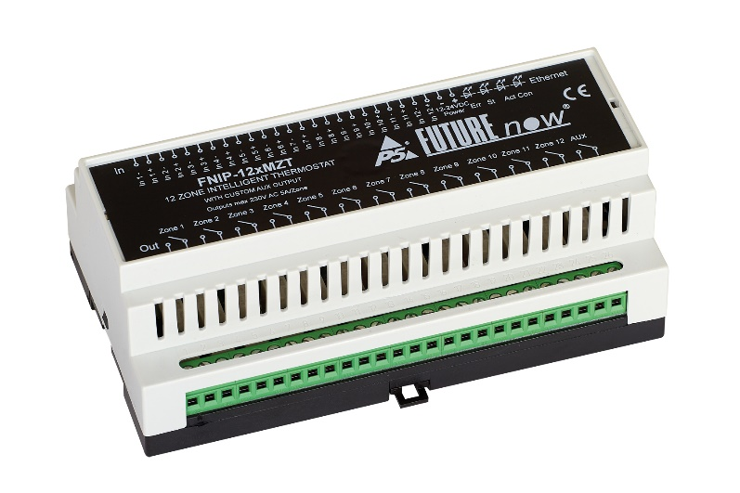
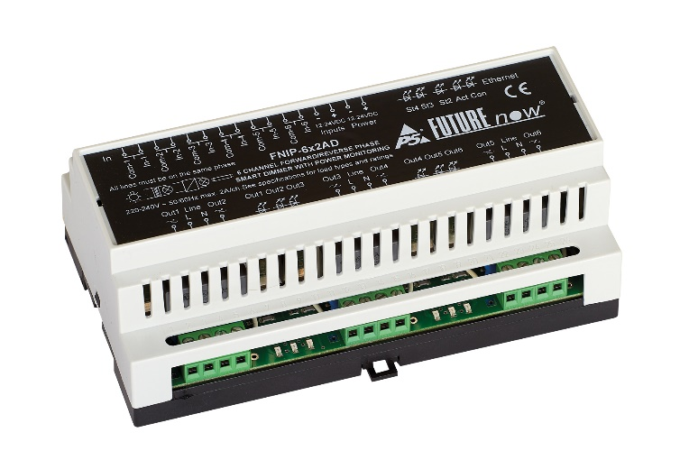
FutureNow
FNIP Product Line
Notes:
9

Slide 10
FutureNow
FNIP Product Line
Features - Optically isolated, multi-purpose inputs
Outputs can be controlled via wall switches connected to the local inputs
This ensures fail safe operation in case the network goes down
Toggle input mode with dimming for dimmers, colour cycle, fade and pick for LED dimmers
Standard switch input mode for the relay module
Follow input mode
Monostable input mode (e.g. staircase lighting)
Independent inputs – can be used to monitor digital sensors and/or activate scenes
Notes:
10

Slide 11
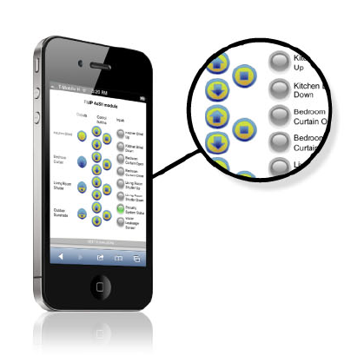
FutureNow
FNIP Product Line
Features – Control via IP
Built in Web Server for configuration, control and monitoring
iOS and Android apps
TCP API
Support for control systems including Control4, RTI, Crestron, AMX, Extron and Savant
Firmware upgrade via LAN
Two way communication - automatic event reports of I/O status changes when controlled via inputs or another controller
Scenes
Notes:
11

Slide 12
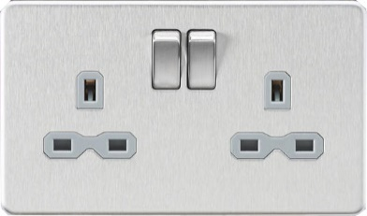
FutureNow
FNIP Product Line
8 Channel IP Relay Module – FNIP-8x16A
All purpose relay switch to control all load types
8 x Heavy duty (230V/16A) potential-free SPDT NO/NC relay outputs
8 x optically isolated digital inputs for on/off or monitoring the status of contact sensors
Supports polarity change DC motor control using special firmware
Notes:
12

Slide 13
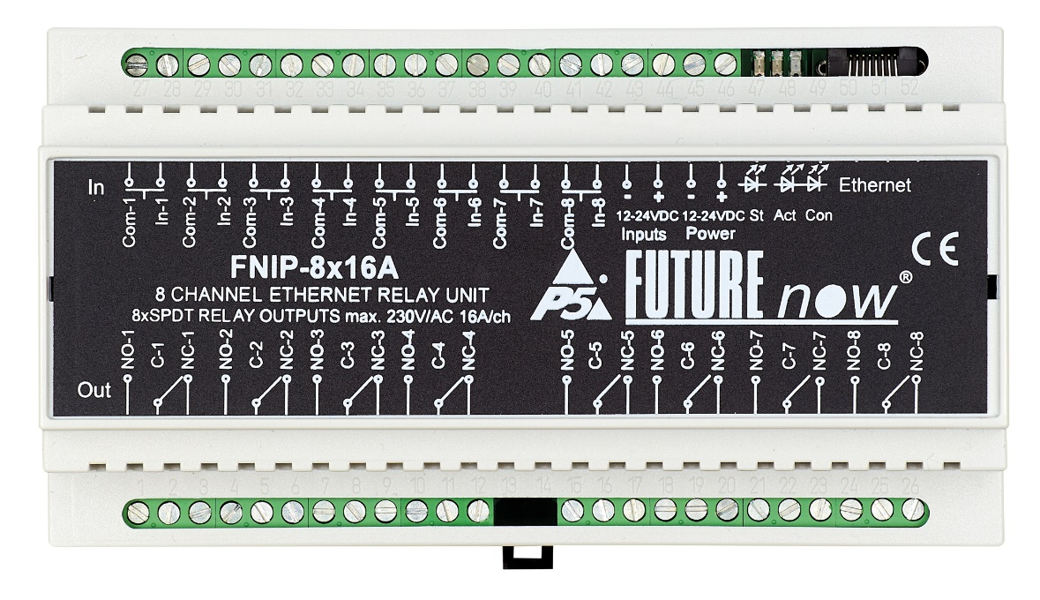
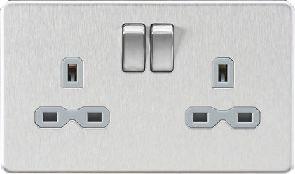
FutureNow
FNIP Product Line
8 Channel IP Relay Module – FNIP-8x16A
Notes:
13

Slide 14
FutureNow
FNIP Product Line
4 Channel IP Blind Controller – FNIP-4xSH
Controls motorized window coverings
4 x outputs for AC motors
4 x optically isolated manual inputs with full up/down/stop functions
Adjustable motor running times
Up/stop/down commands
Go to a certain % command estimated from running times
HW & SW latch to prevent the motor from being driven in both directions at the same time
Delay when changing direction to protect the motor
Notes:
14

Slide 15
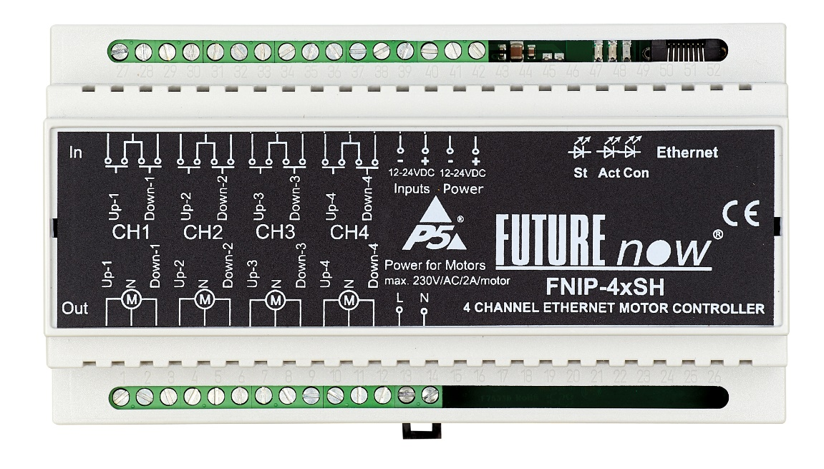
FutureNow
FNIP Product Line
4 Channel IP Blind Controller – FNIP-4xSH
Notes:
15

Slide 16
FutureNow
FNIP Product Line
6 Channel IP Dimmer – FNIP-6x2AD
Forward and reverse phase dimming
Support for both inductive and capacitive loads, including halogens, incandescent & dimmable 230V LEDs
6x channels, 500W load per channel
6x optically isolated inputs for on/off/dim or monitoring the status of contact sensors
Combinable (in pairs) outputs for more wattage
Voltage, Current, Frequency, Temperature, Energy metering
Notes:
16

Slide 17
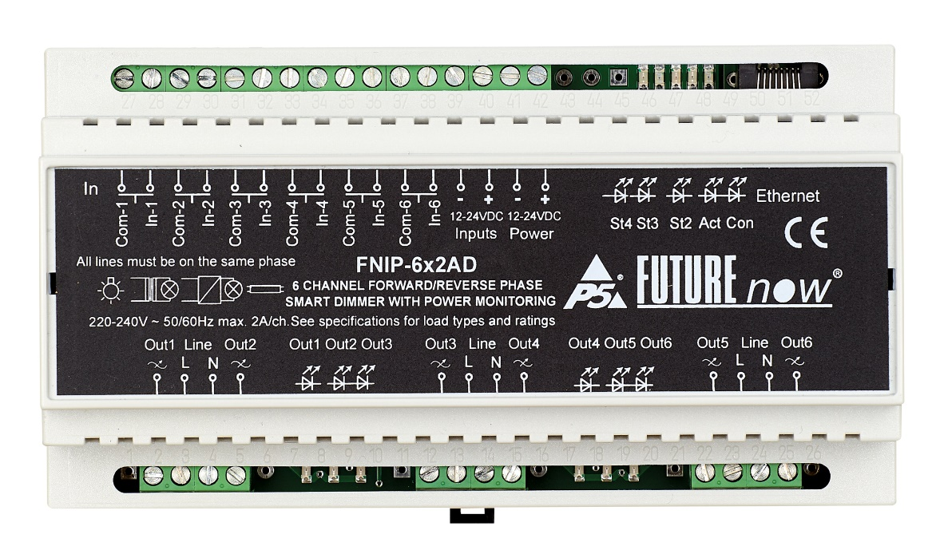
FutureNow
FNIP Product Line
6 Channel IP Dimmer – FNIP-6x2AD
Notes:
17

Slide 18
FutureNow
FNIP Product Line
12 Channel LED Dimmer – FNIP-12xPWM
12 x 4A low-voltage PWM outputs
Supports both 12V and 24V LEDs
Combinable outputs for more wattage (in two groups)
Supports PWM boosters/amps
Flexible powering options for the LEDs
12 optically isolated multi-purpose digital inputs for on/off/dim/colour cycle/colour pick or contact sensors
Single colour, RGB and RGBW LED strip support
Colour picker application
Colour fade with adjustable speed
Notes:
18

Slide 19
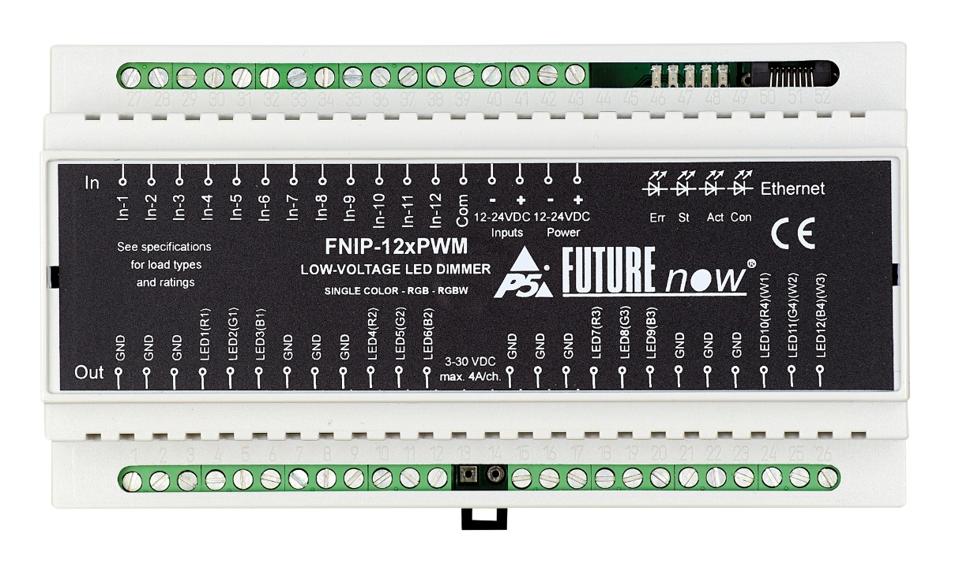
FutureNow
FNIP Product Line
12 Channel LED Dimmer – FNIP-12xPWM
Notes:
19

Slide 20
FutureNow
FNIP Product Line
12 Zone Thermostat – FNIP-12xMZT
12 x Normally Open relay outputs to control valves
12 inputs for analogue temperature sensors
Most sensors used in the industry are supported
Heating, cooling and auto modes
Scheduled heating/cooling programs
Customisable extra relay output ideal for boiler control
Standalone operation. Setpoint and schedule stored, decision made in the module
Notes:
20

Slide 21
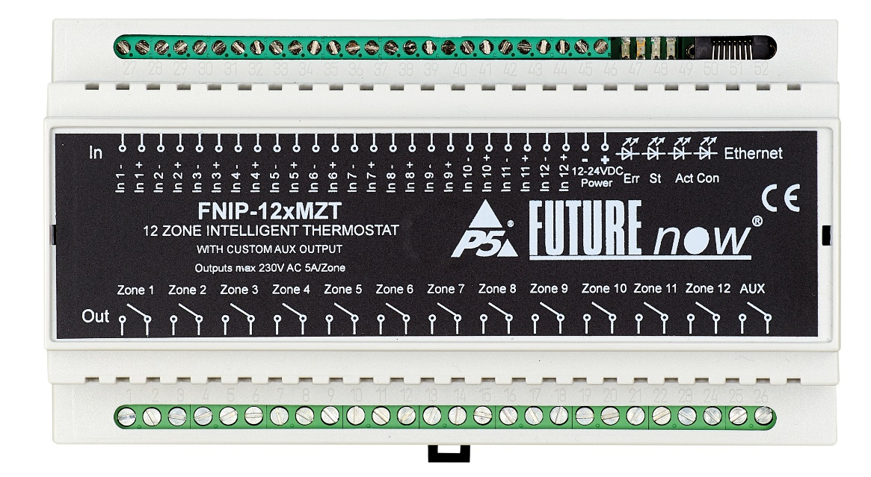
FutureNow
FNIP Product Line
12 Zone Thermostat – FNIP-12xMZT
Notes:
21

Slide 22
Agenda
Introduction to P5
FutureNow FNIP Product Line
FutureNow FNBUS Product Line briefly
Discussion

Slide 23
FutureNow
FN485 Bus Product Line
FN485 bus system features
Dedicated two-wire master-slave bus
System reliability doesn’t rely on third party network elements
If a large number of FN modules is placed next to each other it’s easier to daisy-chain them than to connect them each to a network port
RS232 Gateway
Dimmer, relay and blind controllers with identical functionality to their IP counterparts
0-10V output unit
No LED dimmer and Thermostat
Hybrid system can be built consisting of Bus and IP modules
Notes:
23

Slide 24
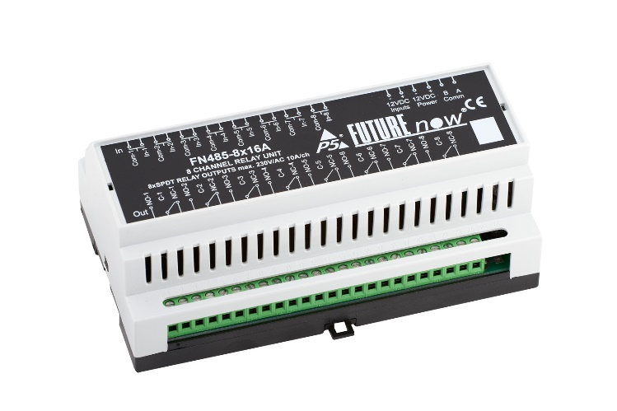
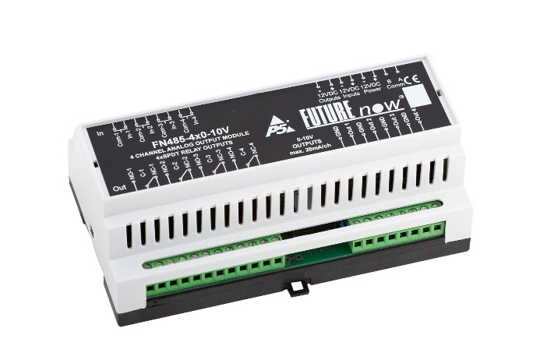
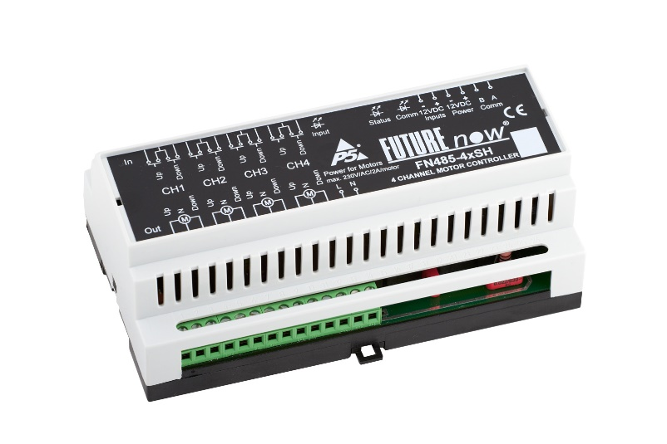
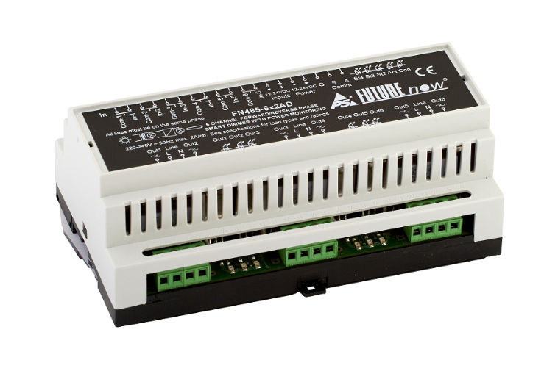
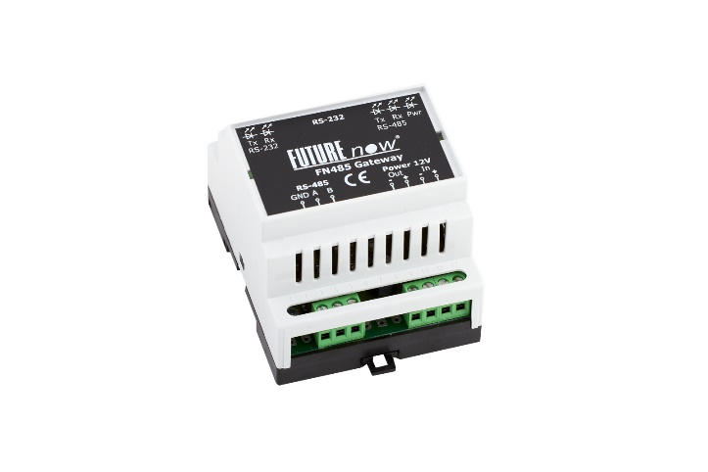
FutureNow
FN485 Bus Product Line
Notes:
24

Slide 25
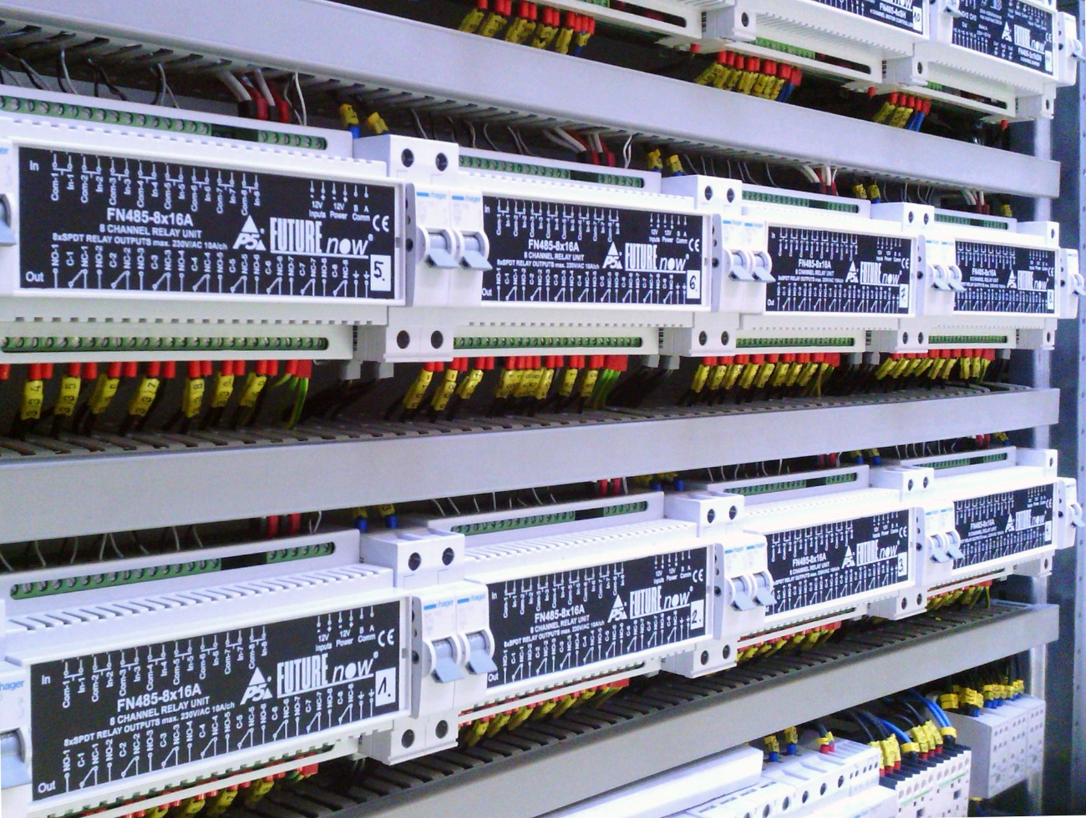
FutureNow
FN modules in action
Notes:
25

Slide 26
Thank you for watching!

